Slide 1




Title: Foreign Direct Investment Analysis
Course: AI
Organization: Nirmaan

Slide 2
Introduction
Investment is a game of understanding historic data of investment objects under different events but it is still a game of chances to minimize the risk.
We apply analytics to find the equilibrium investment.

Slide 3
Contents
Objective
Constraints
Data collection and details
Exploratory Data Analysis
Visualization
Insights
Notes:
Change

Slide 4
Objective
Problem
Investment is a game of chance and is difficult to understand.
Objective of this project
Find the equilibrium investment
Constraints
Minimize the risks
Notes:
Change

Slide 5
These are the below Methodologies
1. Data understanding
2. Data preparation / Data Preprocessing / Data Cleansing
3. Exploratory Data Analysis
4. Data Visualization 5. Insights
Methodology

Slide 6
Technical Stacks
1) ETL - Extract, Transform and Load process is used.
2) Key Metrics – Sector-wise and Year-wise Investments.
3) Libraries used – pandas, matplotlib, seaborn
4) Visualization – Bar plots, Line plots

Slide 7
Data Collection and Understanding
Data Collection: FDI Dataset
Our Dataset is an excel file that contains the details of Foreign Investment in India.

Slide 8
Data Preprocessing & EDA
Data Loading:
The dataset is loaded and we are dropping the missing values.
Data Transformation:
Creating new columns like Amount, Year using melt functionality.
Data Extraction:
Calculating the sector-wise and year-wise investments.
Below is the code:
link
Notes:
Keep observations

Slide 9
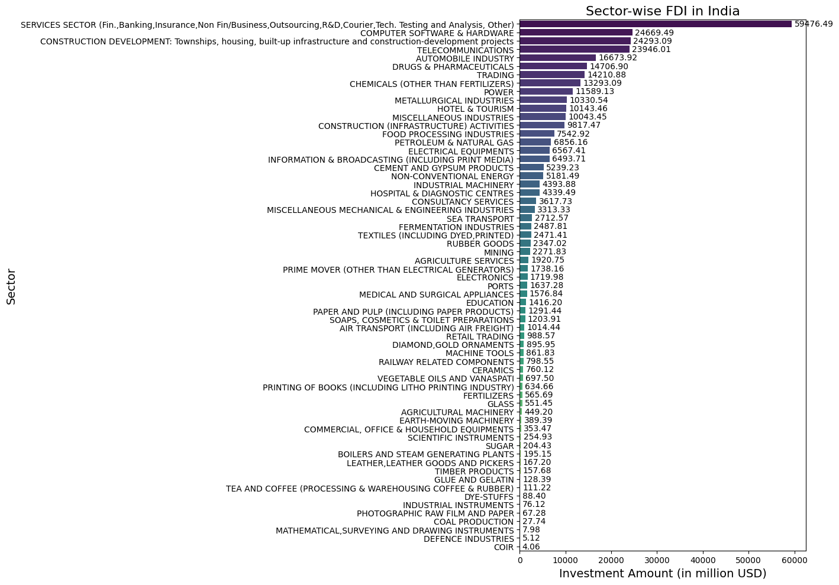
Data Visualization
Sector-wise Investments Visualization
Notes:
Keep observations

Slide 10
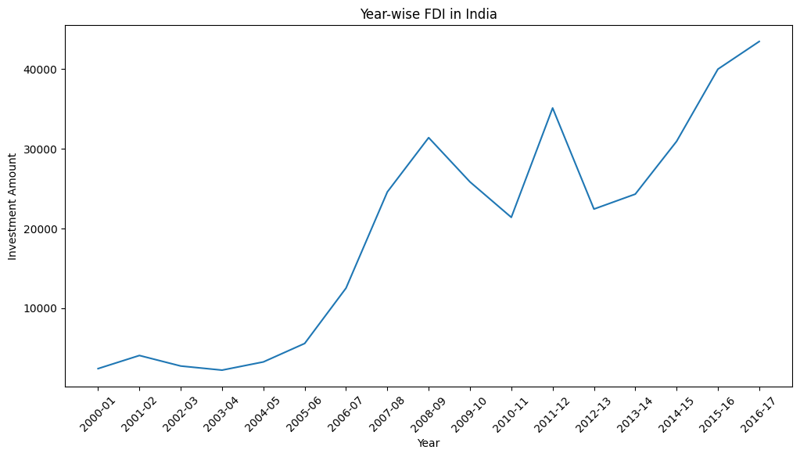
Data Visualization
Year-wise Investments Visualization
Notes:
Keep observations

Slide 11
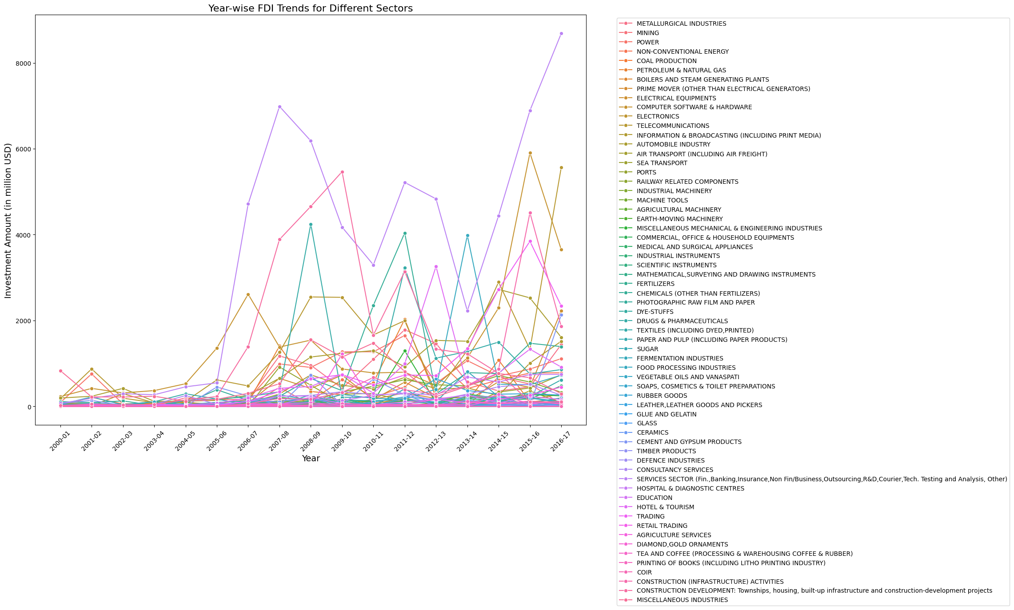
Output
Notes:
Keep observations

Slide 12
Insights
Top Sectors for FDI: The sectors receiving the highest FDI are evident from the line plot. Sectors such as Services Sector (includes Financial, Banking, Insurance, Non-Financial/Business, Outsourcing, R&D, Courier, Tech. Testing and Analysis, Other) have attracted significant investment.
Yearly Investment: The years from 2007-2008 and 2016 – 2017 have had the highest investments from the top sectors.
Growth Sectors: Certain sectors, like Telecommunications, Computer Software & Hardware, and Construction (Infrastructure) Activities, also show substantial FDI inflows, highlighting their growth potential and attractiveness to foreign investors.

Slide 13
Further Analysis
Year-wise Trends: Conduct a similar analysis for year-wise FDI inflows to identify trends over time. This can help in understanding the impact of policy changes, economic conditions, or global events on FDI.
Country-wise Analysis: Analyze the source countries for FDI. Understanding which countries are investing heavily can help in tailoring bilateral agreements and trade policies.
Sector Interdependencies: Investigate how different sectors are interlinked. For example, growth in the Telecommunications sector might drive FDI in Technology or Services sectors.
Impact Analysis: Assess the impact of FDI on economic indicators such as GDP growth, employment rates, and technological advancements. This can provide a more comprehensive view of how FDI is influencing the overall economy.

Slide 14
Thank You

